Slide 3
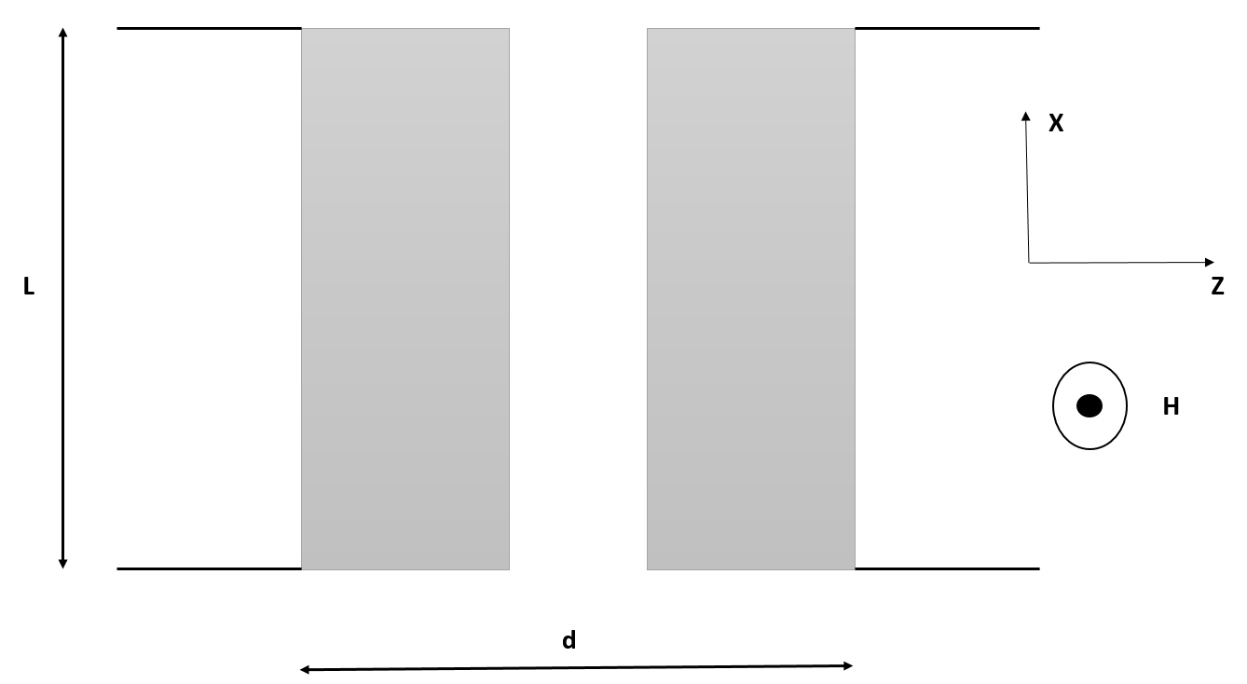





$$λ_{L}$$
$$λ_{R}$$
$$C_{L}$$
$$C_{R}$$
$$t$$

